Slide 1
Lecture 16
Software Design & Design Engineering
BSCS (Software Engineering-I) SZABIST-Islamabad

Slide 2

Analysis Model -> Design Model
BSCS (Software Engineering-I) SZABIST-Islamabad

Slide 3
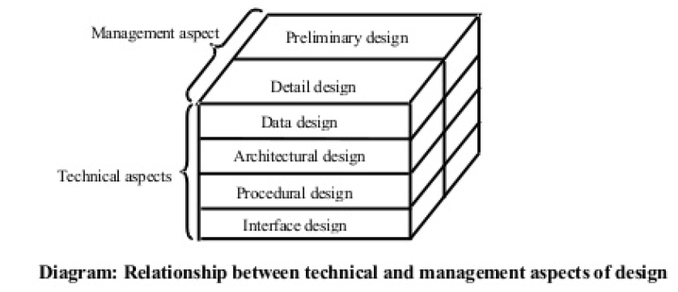
Elements of the analysis model
BSCS (Software Engineering-I) SZABIST-Islamabad

Slide 4
Software Design
A process through which requirements are translated into a representation of software. From a project management point of view, software design can be conducted in two main steps:
Preliminary Design
Concerned with the transformation of requirements into data and software architecture.
Detail design
Focuses on refining the architectural representation, and lead to detailed data structure and algorithmic representations of software.
BSCS (Software Engineering-I) SZABIST-Islamabad

Slide 5
1.Data Design
There are seven principles of Data design;
Apply Systematic Analysis:
(The same good principles that are followed in analysis principles should also be applied to help us develop data flow and content, identify data objects, and consider alternative data organization.)
Identify Data Structures and the operations.
Create data dictionary
Information Hiding.
Creation of a library of useful data structures and the operations
Programming Language
Deferred Low-level data design
BSCS (Software Engineering-I) SZABIST-Islamabad

Slide 6
2. Architectural Design
“The architecture of a system describes its major components, their relationships (structures), and how they interact with each other.”
The primary objective in Architectural Design is to develop a modular program structure and represent the control relationships between modules.
In addition, architectural design combines program structure and data structure, thus defining interfaces that will enable data to flow throughout the program.
Data centered architectures:
Data flow architectures:
Object Oriented architecture:
Layered architecture:
BSCS (Software Engineering-I) SZABIST-Islamabad

Slide 7
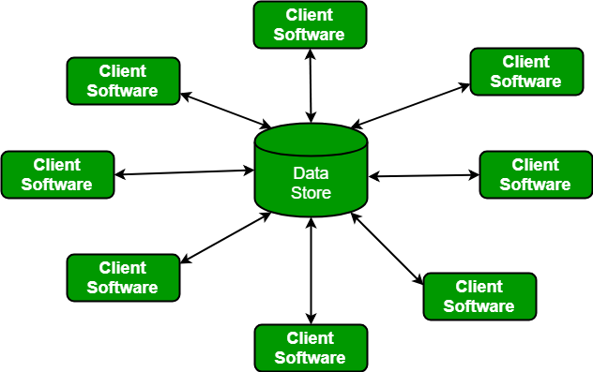
Architectural Design
Data centered architectures:
A data store will reside at the center of this architecture and is accessed frequently by the other components that update, add, delete or modify the data present within the store.
BSCS (Software Engineering-I) SZABIST-Islamabad

Slide 8
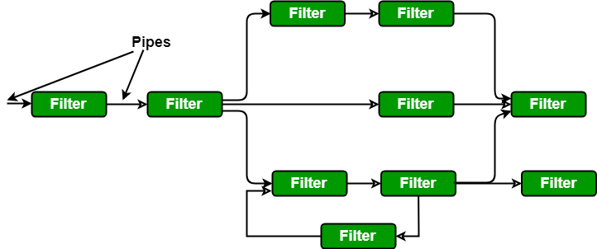
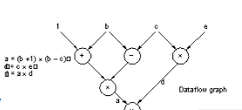
Architectural Design
Data flow architectures:
This kind of architecture is used when input data to be transformed into output data through a series of computational manipulative components.
BSCS (Software Engineering-I) SZABIST-Islamabad

Slide 9
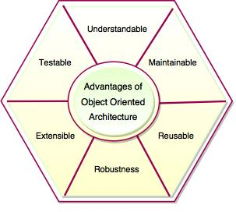
Architectural Design
Object Oriented architecture:
Object Oriented Architecture is an important concept for developing the software. It is a design paradigm based on the division of responsibilities for an application or system into individual reusable and self-sufficient objects. The popular approach of object-oriented design is to view a software system as a collection of entities known as objects.
The components of a system encapsulate data and the operations that must be applied to manipulate the data. The coordination and communication between the components are established via the message passing.
BSCS (Software Engineering-I) SZABIST-Islamabad

Slide 10
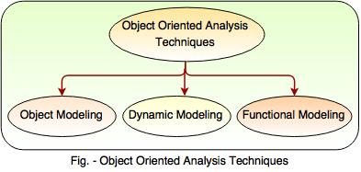
Object Oriented Analysis
Following are the three techniques of object oriented analysis:
1) Object Modeling
2) Dynamic Modeling
3) Functional Modeling
BSCS (Software Engineering-I) SZABIST-Islamabad

Slide 11
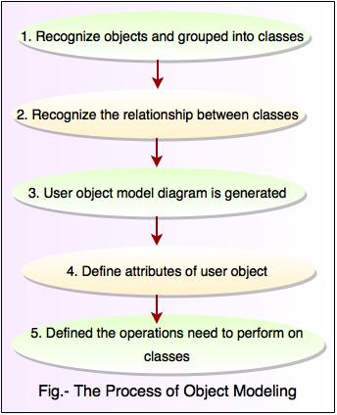
1.Object Modeling
BSCS (Software Engineering-I) SZABIST-Islamabad

Slide 12
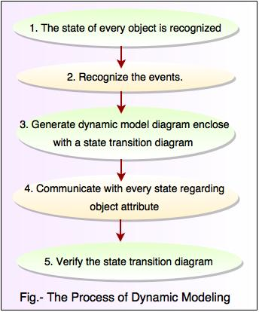
2. Dynamic Modeling
BSCS (Software Engineering-I) SZABIST-Islamabad

Slide 13
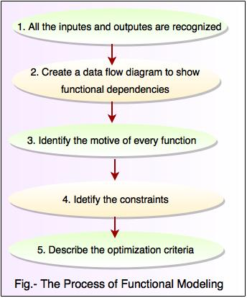
3. Functional Modeling
BSCS (Software Engineering-I) SZABIST-Islamabad

Slide 14
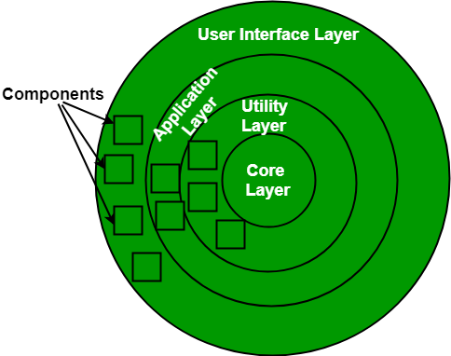
Architectural Design
Layered architecture:
A number of different layers are defined with each layer performing a well-defined set of operations. Each layer will do some operations that becomes closer to machine instruction set progressively.
BSCS (Software Engineering-I) SZABIST-Islamabad

Slide 15
Procedural Design
The objective in Procedural Design is to transform structural components into a procedural description of the software. This step occurs after the data and architectural design.
Procedural details can be represented in different ways:
Graphical Design Notation
Tabular Design Notation
Program Design Language (PDL)
BSCS (Software Engineering-I) SZABIST-Islamabad

Slide 16
Procedural Design
Graphical Design Notation
The most widely used notation is the flowchart. Some notation used in flowcharts are
Boxes to indicate processing steps;
Diamond to indicate logical conditions;
Arrows to indicate flow of control;
Two boxes connected by a line of control will indicate a Sequence.
BSCS (Software Engineering-I) SZABIST-Islamabad

Slide 17
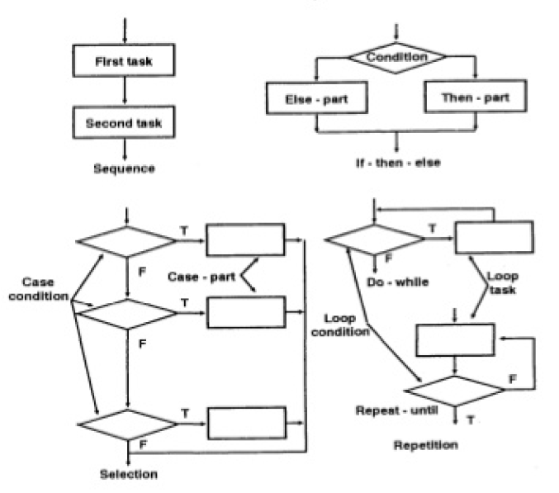
Procedural Design
BSCS (Software Engineering-I) SZABIST-Islamabad

Slide 18
Procedural Design
Tabular Design Notation
Decision tables provide a notation that translates actions and conditions (described in a processing narrative) into a tabular form.
The upper left-hand section contains a list of all conditions. The lower left-hand section lists all actions that are possible based on the conditions. The right-hand sections form a matrix that indicates condition combinations and the corresponding actions that will occur for a specific combination.
BSCS (Software Engineering-I) SZABIST-Islamabad

Slide 19
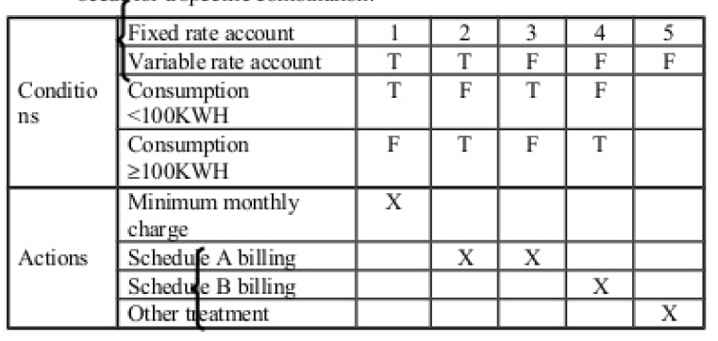
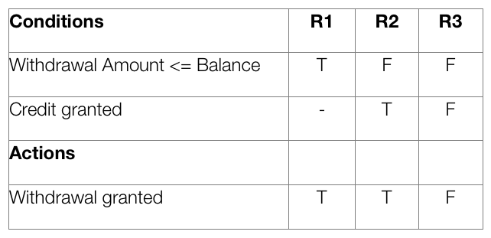
Procedural Design
BSCS (Software Engineering-I) SZABIST-Islamabad

Slide 20
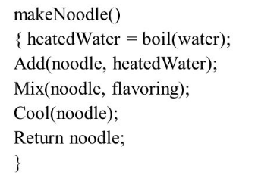
Procedural Design
Program Design Language
Program Design Language (PDL) is also called structured English, or Pseudocode.
The main difference between PDL and its nearest neighbor, 4th Generation Languages, is that in PDL, the use of narrative text (e.g. English) is embedded directly within PDL statements.
BSCS (Software Engineering-I) SZABIST-Islamabad

Slide 21
Procedural Design
PDL have the following characteristics:
A fixed syntax of keywords that provide for all structured constructs, data declaration, and modularity characteristics
A free syntax of natural language that describes processing features
Data declaration facilities that should include both simple (scalar, array) and complex (linked list or tree) data structures.
Subprogram definition and calling techniques that support various methods of interface description.
BSCS (Software Engineering-I) SZABIST-Islamabad

